Slide 1

LETTER
MADE BY:
SAWERA SAEED
21SW129
Notes:
Line spacing + Page numbers

Slide 2
What is letter?
A letter is a form of written communication between two people.
Letter are usually sent to the recipient via mail or post in an envelope.
Letter are divided into two main types:

Slide 3
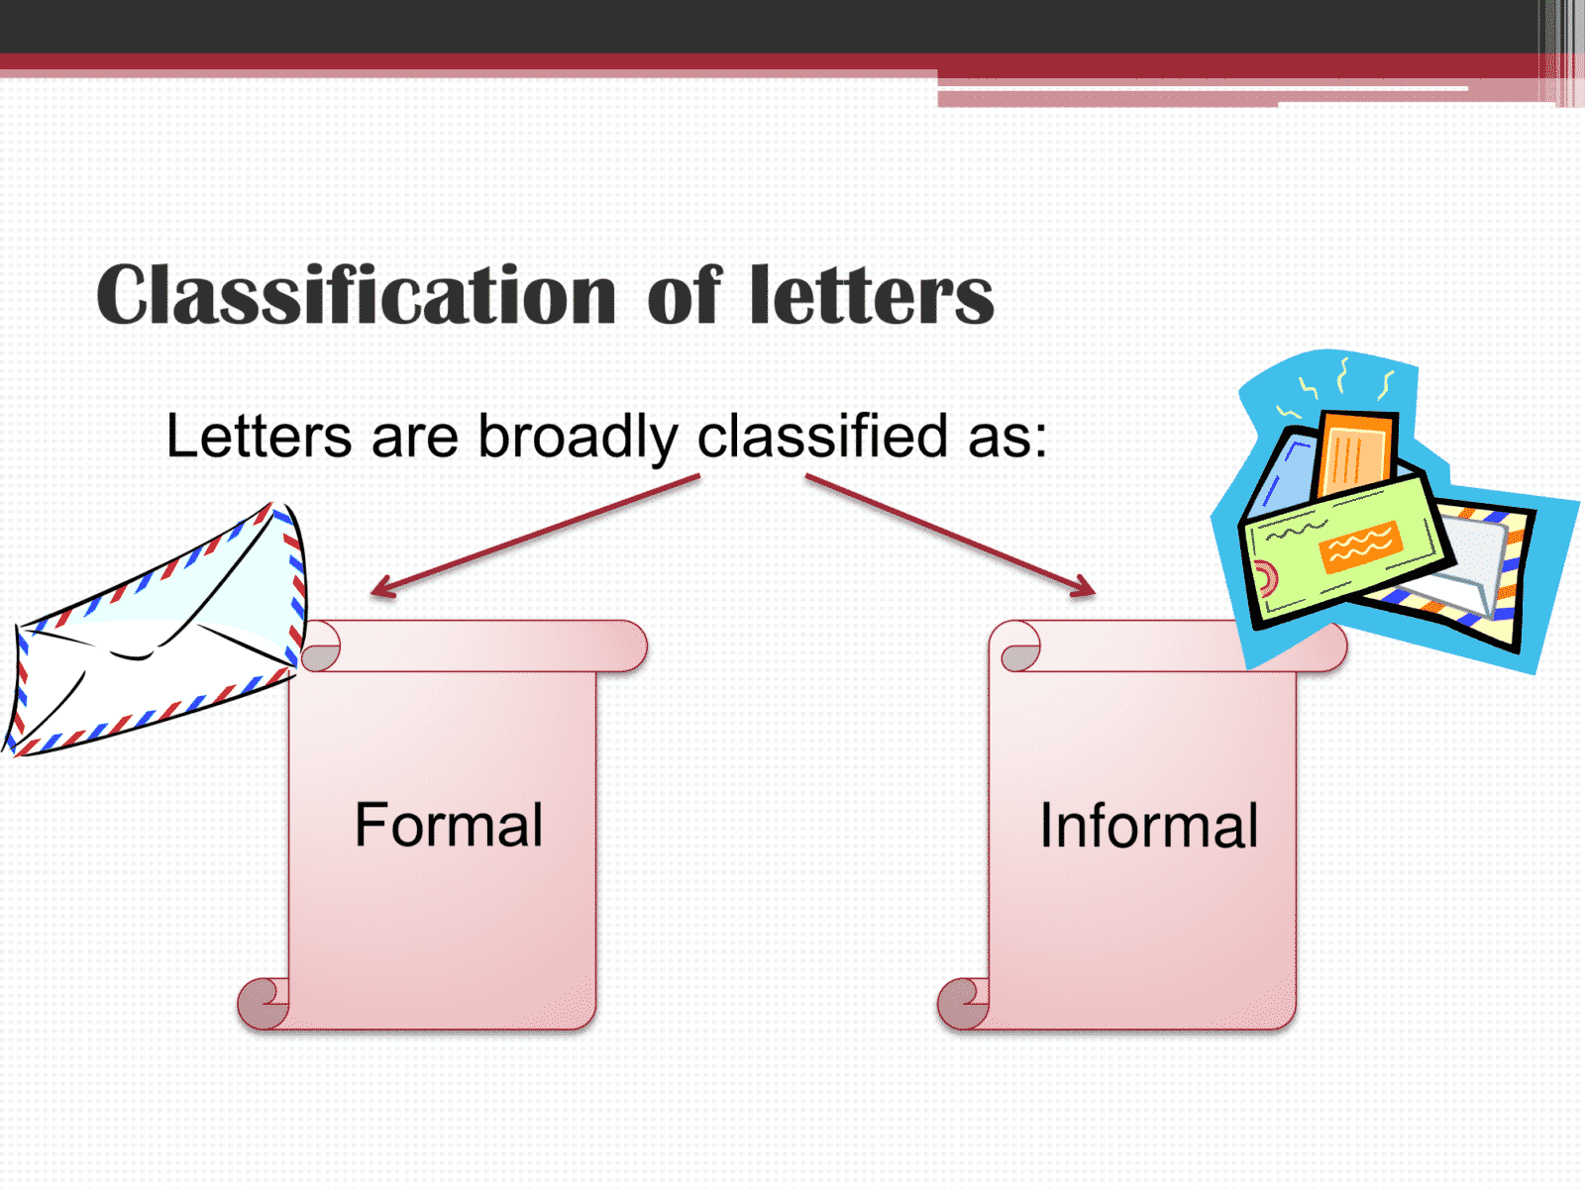
Types of letter:

Slide 4
Formal letter:
A formal letter is written in a formal language and follows a certain stipulated format. Such letters are written for official purposes to authorities, colleagues, seniors, etc. and not to personal contacts, friends or family..

Slide 5
Informal letters:
An informal letter is the type of letter you would write to someone you know, for example a friend or family member. They're written in a style that is more friendly and familiar in comparison to a formal letter which follows strict rules.

Slide 6
Types of formal letter:
Letter of Enquiry.
Order Letter.
Letter of Complaint.
Reply to a Letter of Complaint.
Promotion Letter.
Sales Letters.
Recovery Letters.

Slide 7
Types of informal letters:
Birthday wish.
Sorry or apologizing someone.
Invitation for wedding, parties, etc.
Congratulating.
asking for help from someone.

Slide 8
Greetings in formal letters:
Dear sir,
Dear madam,
Respected sir,
Respected madam,

Slide 9
Dear friend,
My dear friend,
Dear father/mother,
Greeting in informal letters:

Slide 10
With gratitude, With respect, Yours sincerely, Yours cordially, Yours truly, Thankyou, Regards, Yours respectfully,
Complimentary closes in formal letter:

Slide 11
Best wishes, Best, Kindly, Kind regards, Lots of love, Love, Yours lovingly,
Complimentary closes for informal letters:

Slide 12
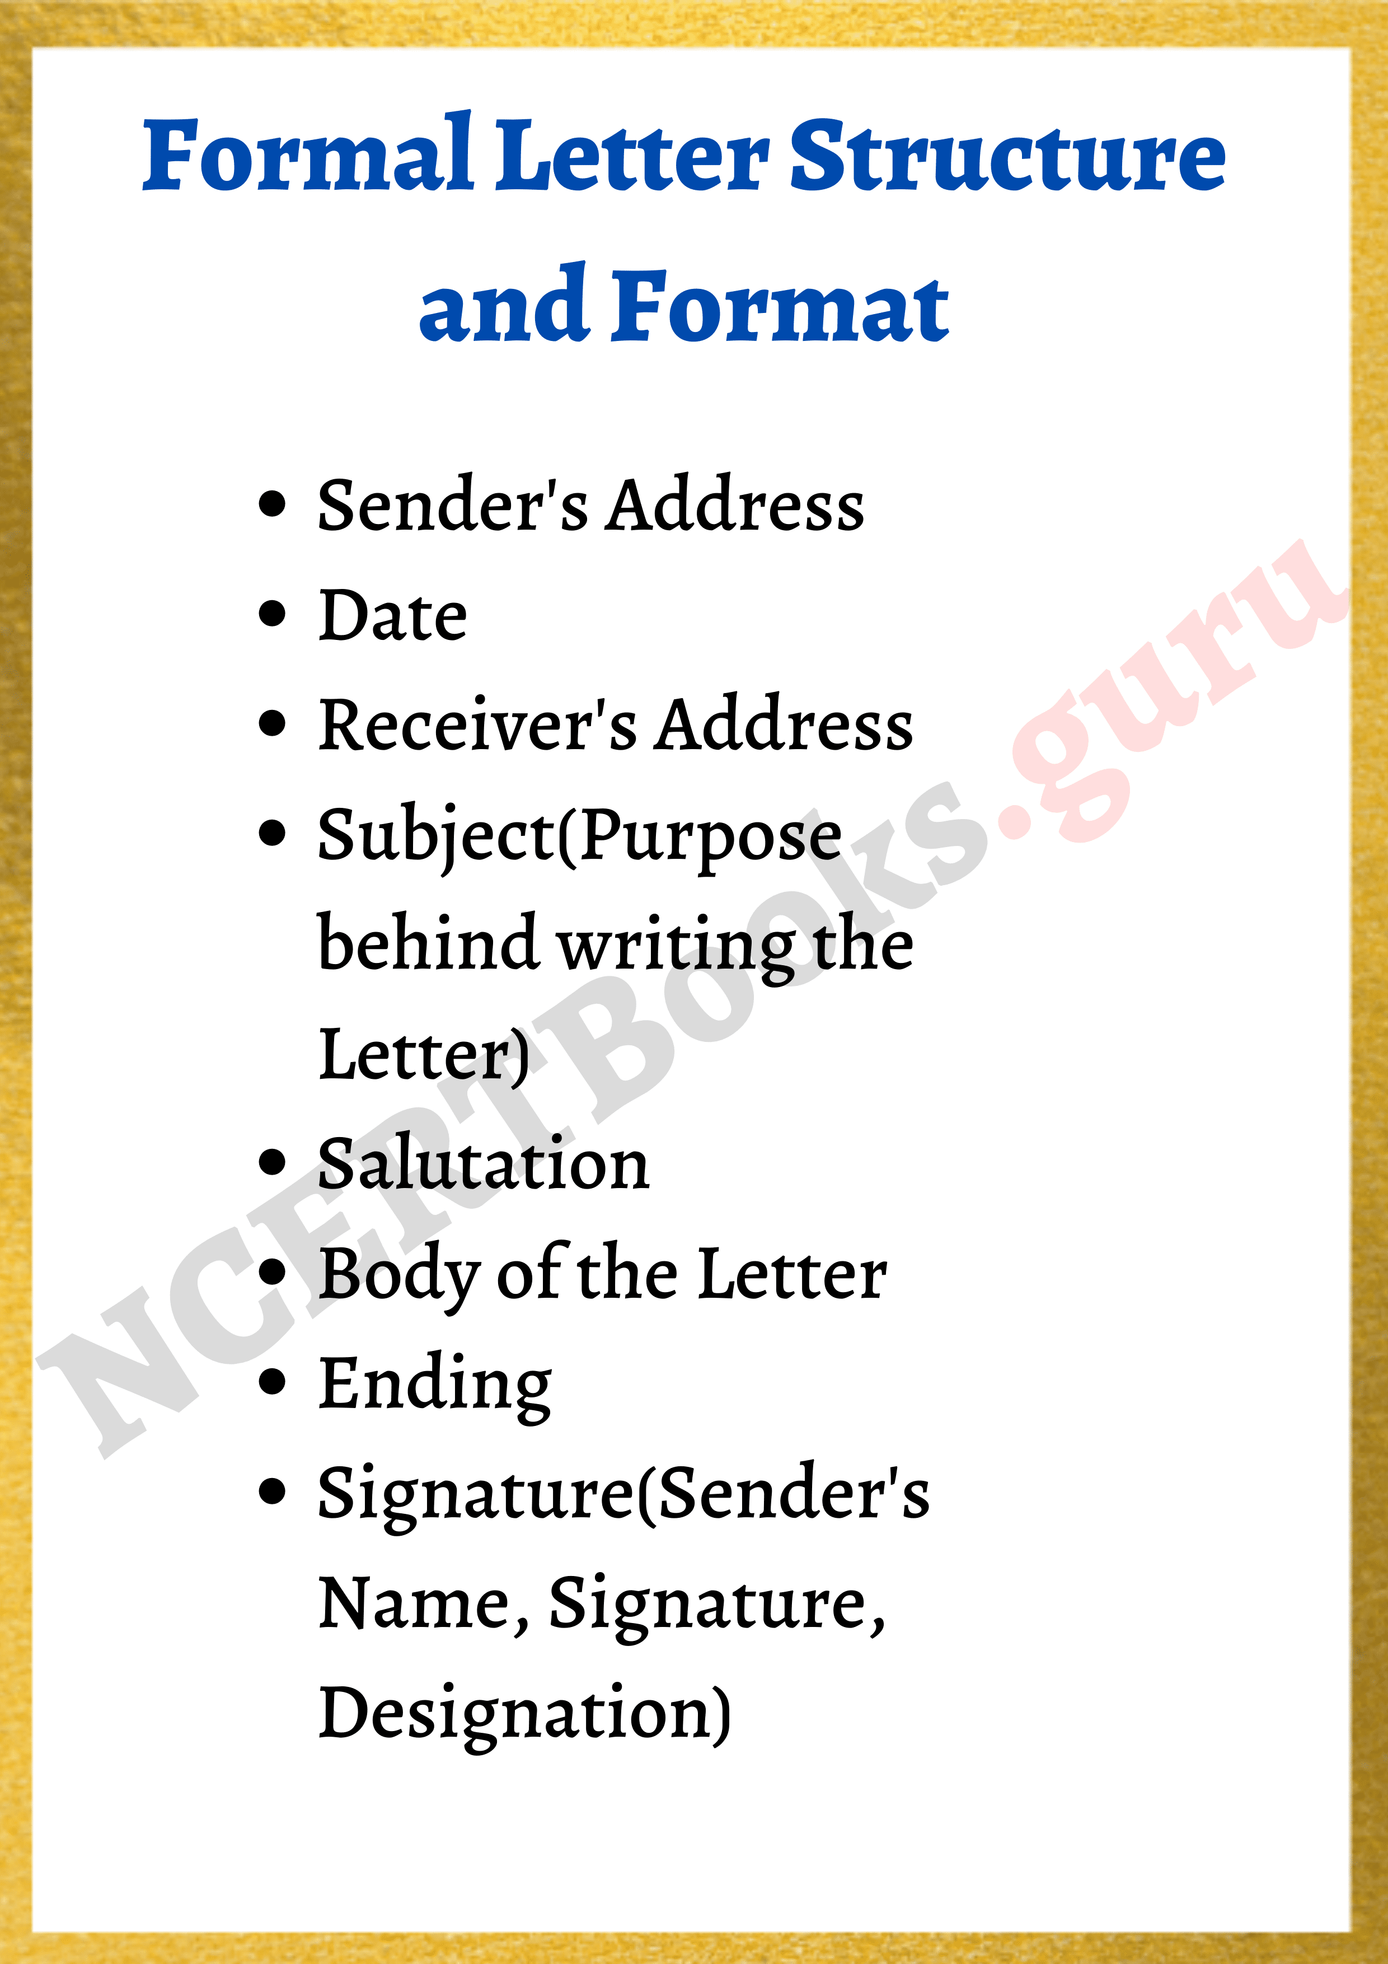
Format of writing formal letter:

Slide 13
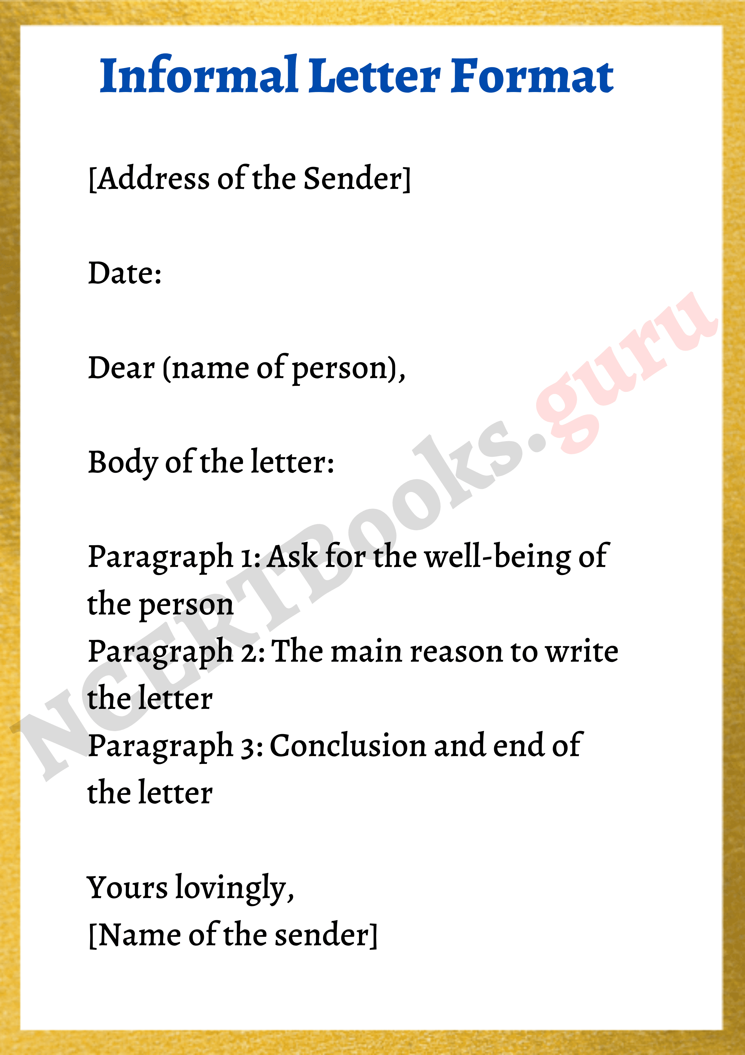
Format of writing informal letters:

Slide 14
Thankyou!

